Slide 1

NYC’s Citibike Data Analyzed & Visualized

Slide 2
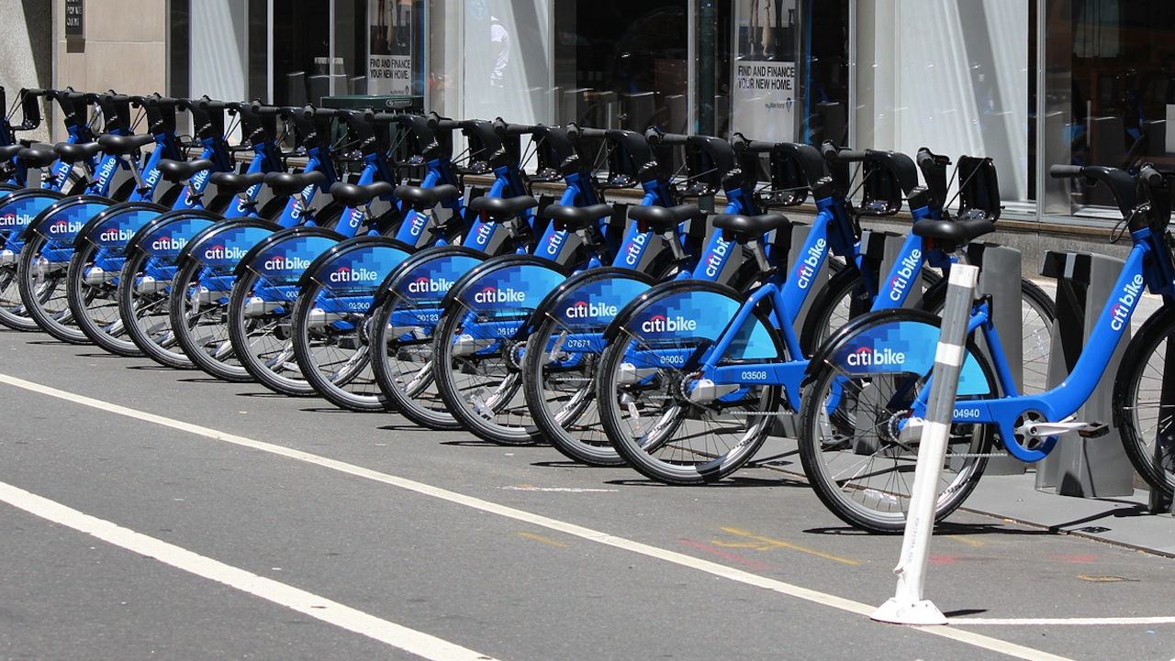
The numbers:
472 Unique stations in New York City
7,256 bikes available for use
45 mins is max trip time, pay overtime for each minute after

Slide 3
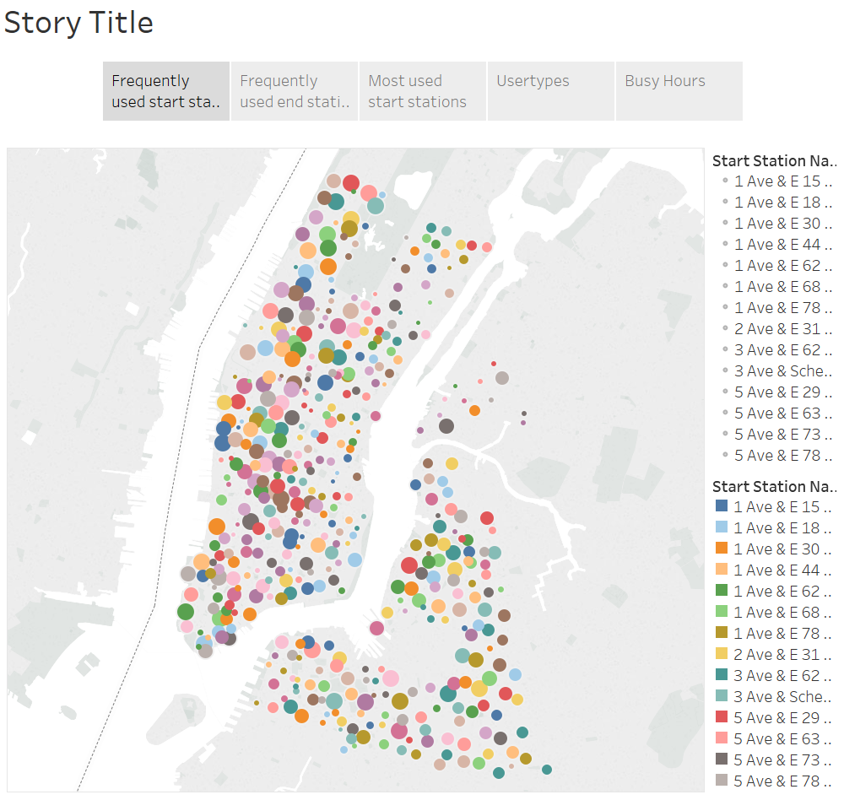
Frequent Start Stations

Slide 4
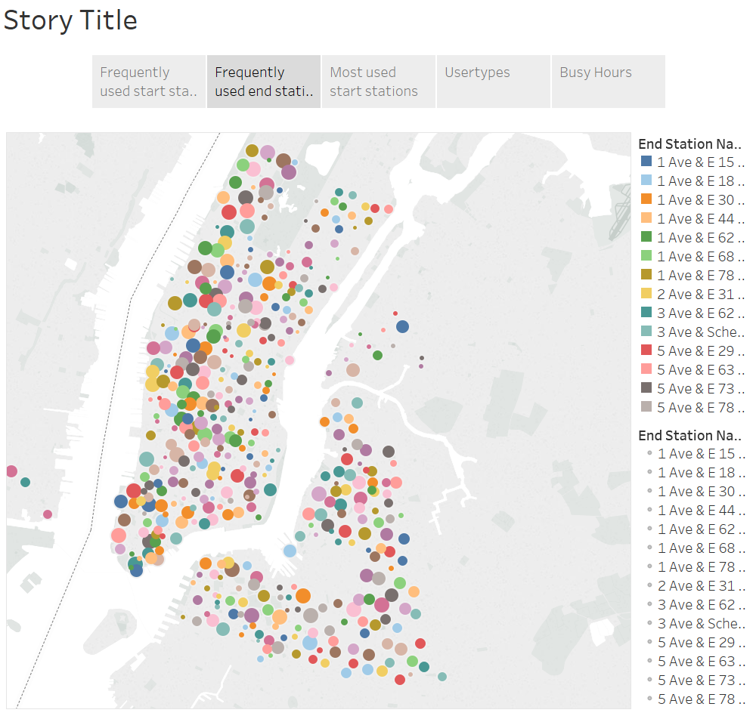
Frequent Stop Stations

Slide 5
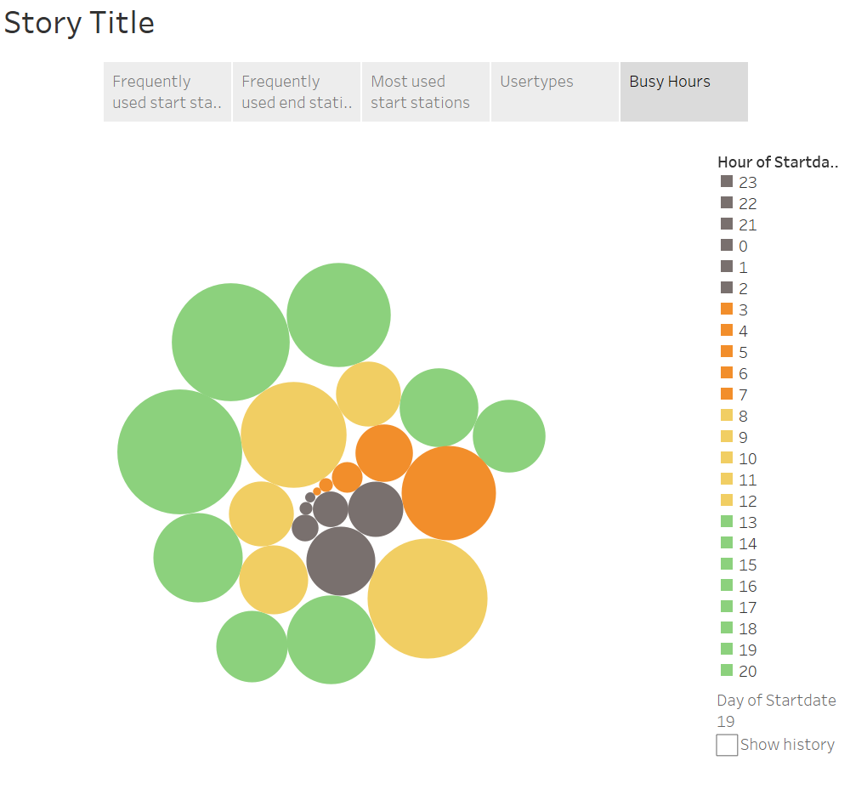
Busy hours of the day Late night – Least Evening – Highest Moderate traffic in between People must be using citibikes to commute to work

Slide 6
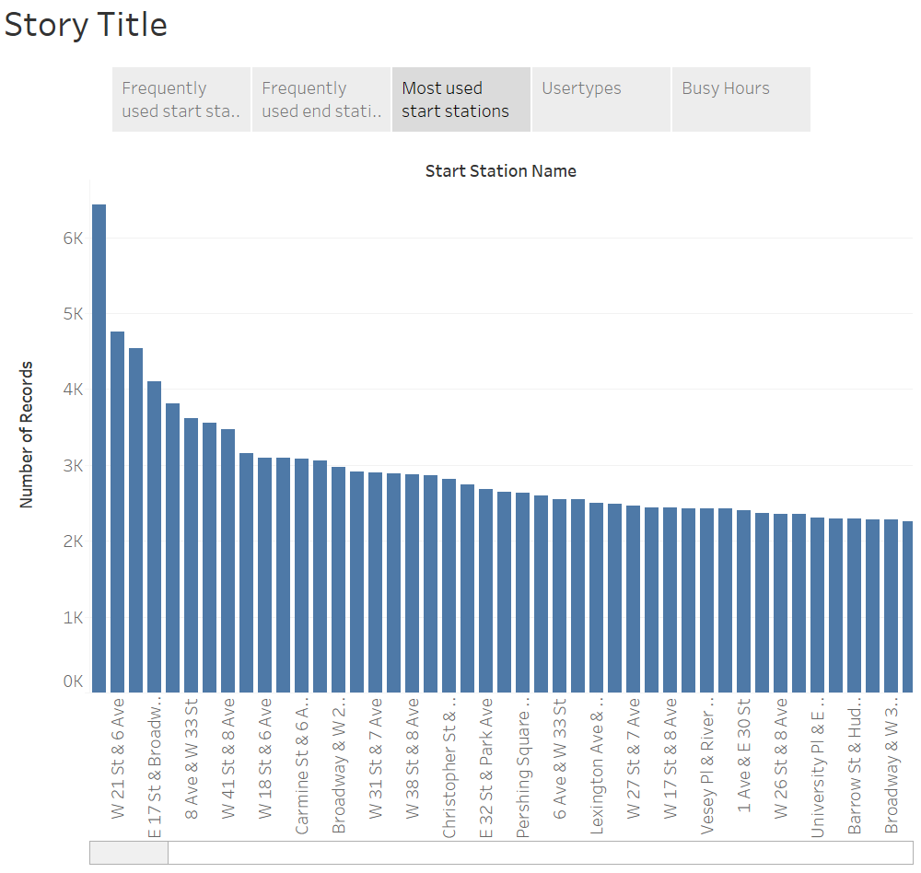
Most frequently used stations 1. Perishing Square North 2. W21st & 6th Ave 3. E17 St & Broadway 4. 8 Ave & W33 St

Slide 7
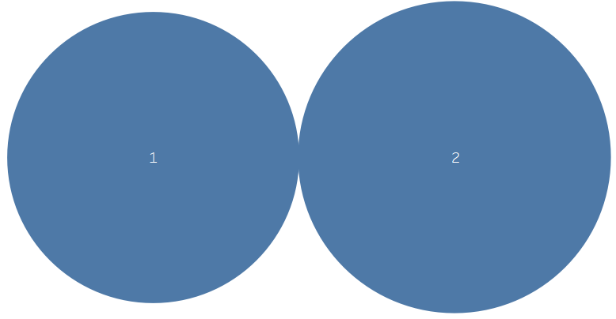
Trip duration by Gender
Male
Female
Median trip duration for females is higher than male
Male: 8.2 Minutes
Female: 9.4 Minutes

Slide 8
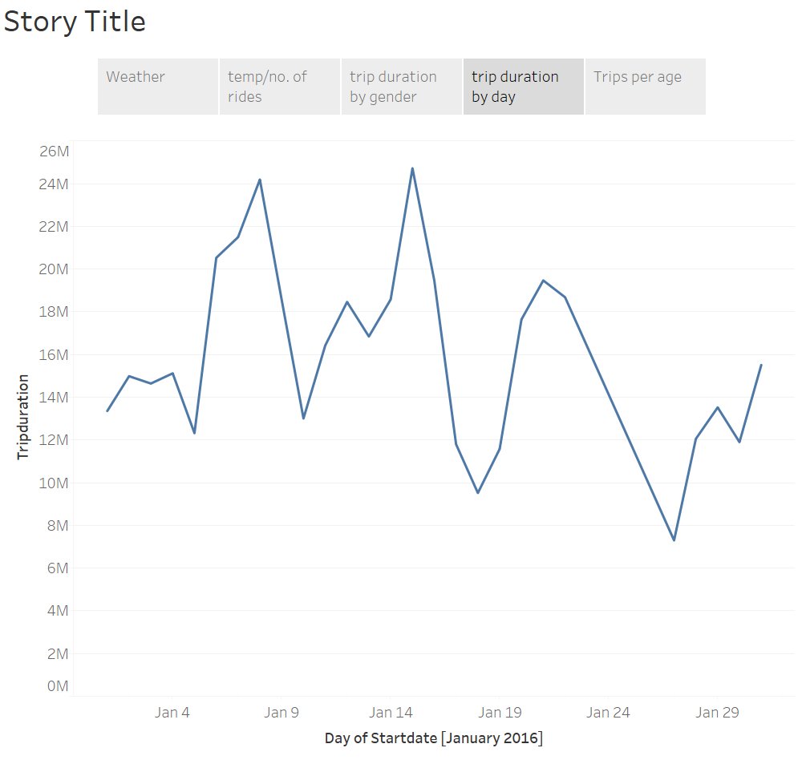
Trip duration by day of the month Trip durations are longer on Weekends! Especially from Thursday to Saturday
People ride the bikes more often at the end of the week.
“Most baby diapers and beers are sold on Thursdays & Saturdays” – Data Science Article
Weekend shopping trips – Joy rides – Exercise

Slide 9
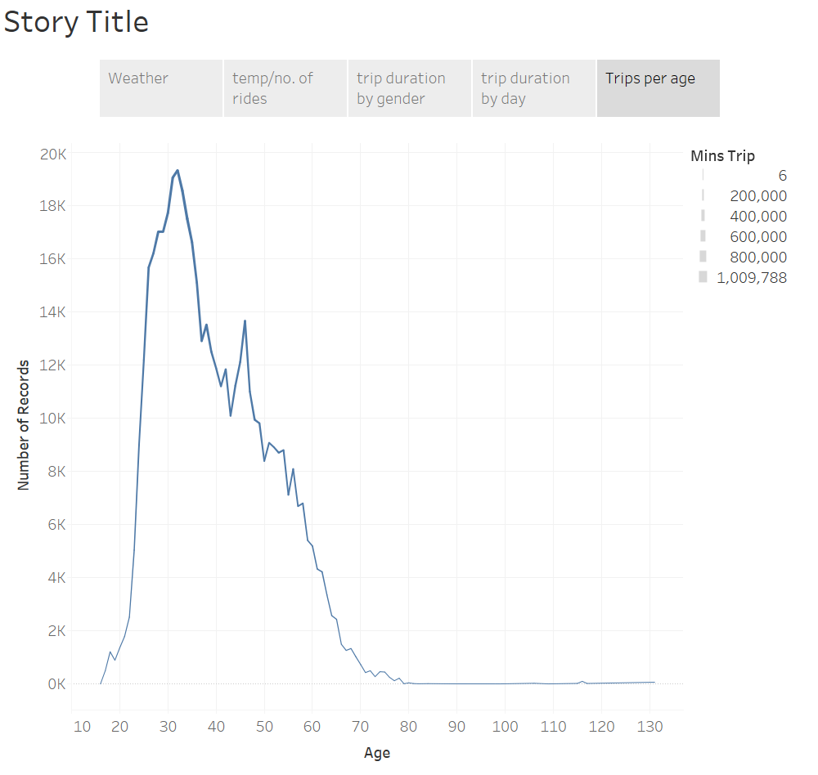
No. of trips by age Average age of frequent users: 28 – 34 Riders who were 46 years old also had high usage compared to their age group

Slide 10
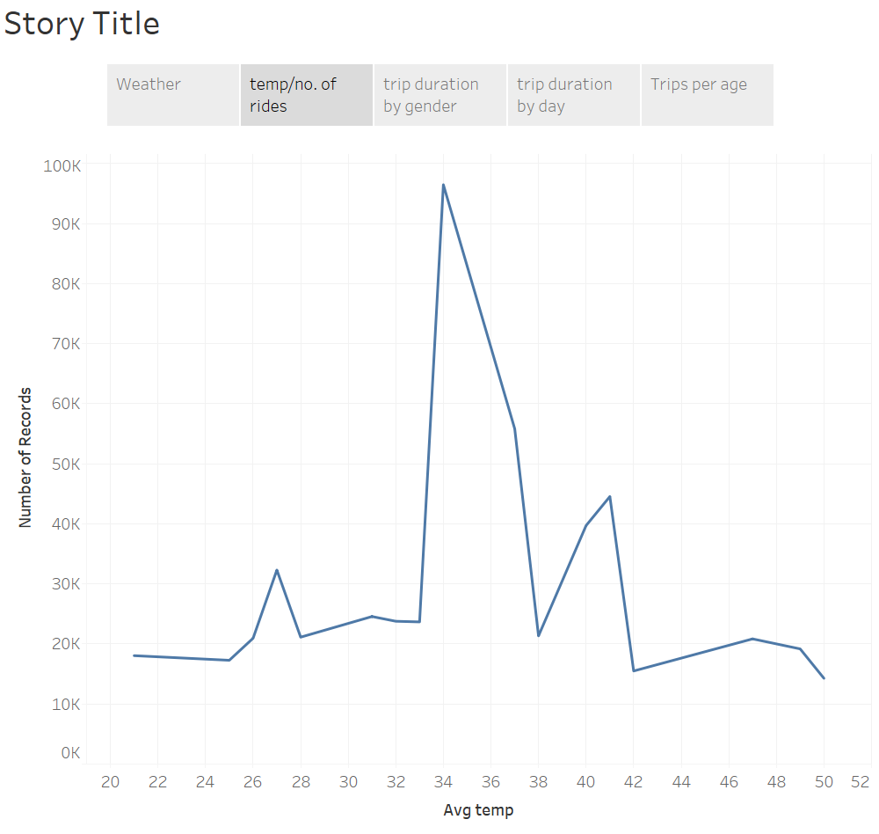
Use by temperature When the average daily temperature was between 33*F to 35*F people used Citibike as usual When it got warmer, non-daily users also preferred to ride Usage decreases as temp gets too cold

Slide 11
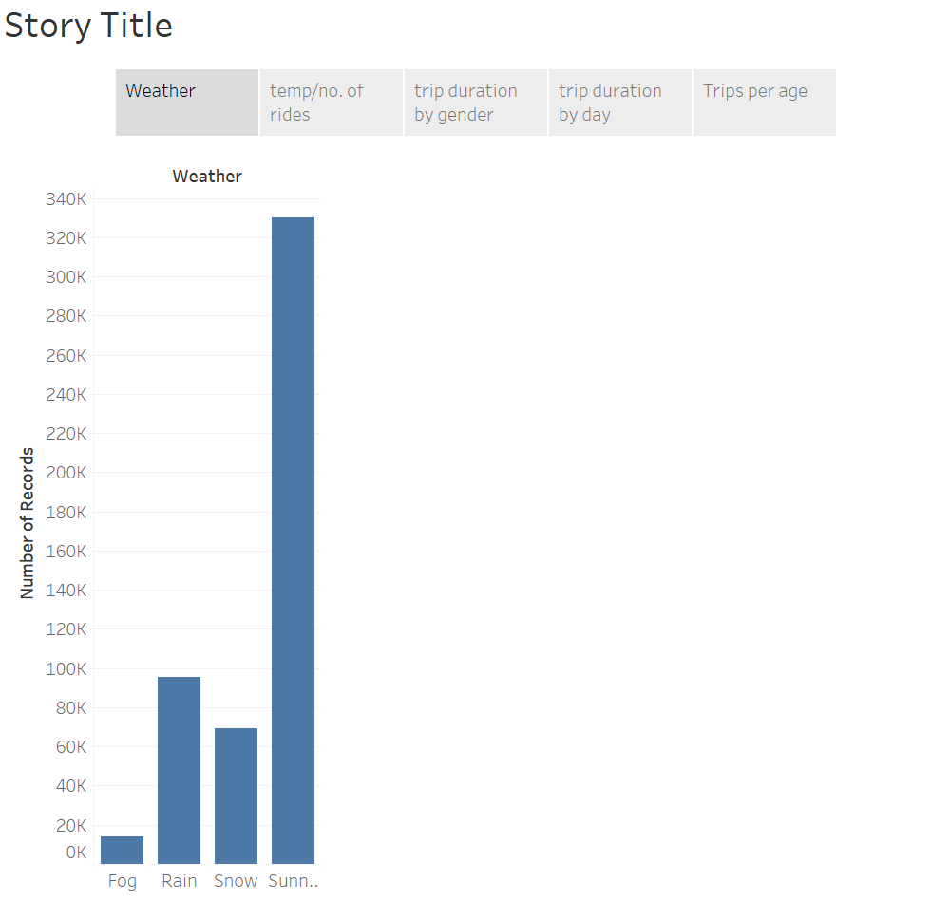
Trips by Weather Sunny – Maximum Fog – Least People avoid riding during Fog, Rain and Snow

Slide 12
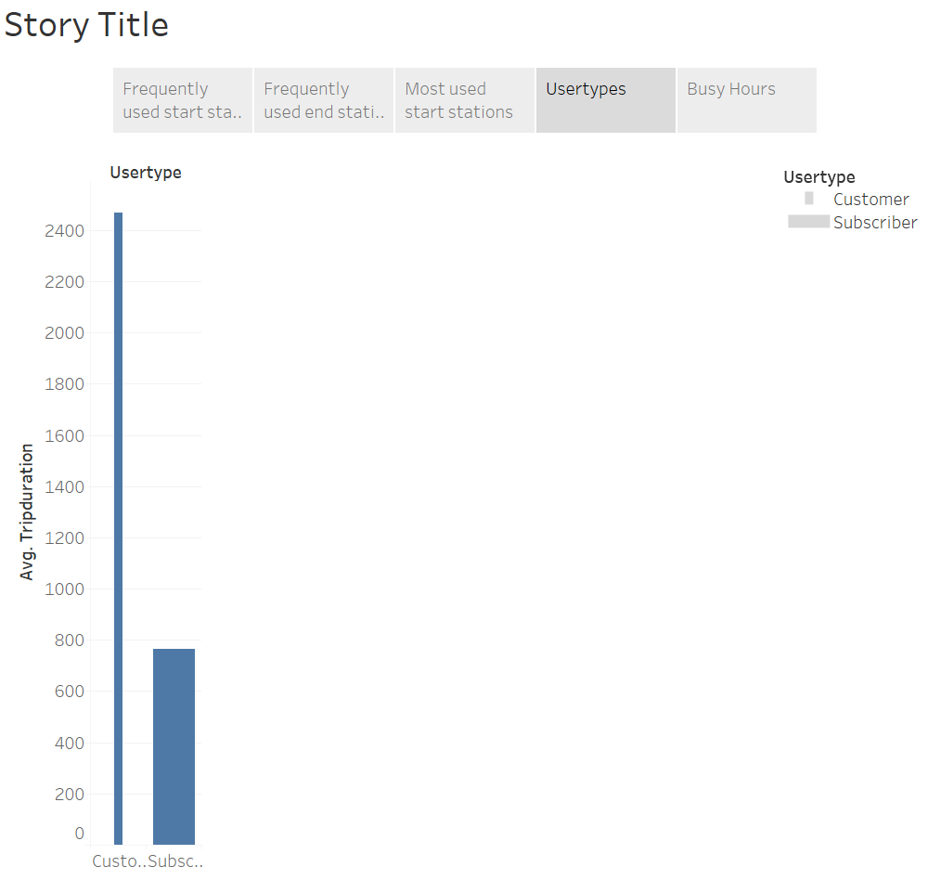
Usage of Citibikes per customer types Subscribers ride shorter trips but there are far more subscribers than one time customers One-time customers are usually tourists who go out on tours using citibikes, hence they ride longer distances

Slide 13
In conclusion,
There’s plenty of things we can take in account.
For example, we could calculate the speed as we have distance and time. We could also take in consideration, the effect of bad weather over speed.
We could further classify more details as we gather more data. This was the data from January 2016, a winter month. We could also compare the usage of Citibikes in extreme cold or extreme heat, what type of weather are New Yorkers more comfortable riding?

